Slide 1

AL-FARABI KAZAKH NATIONAL UNIVERSITY
Department of political science and political technologies
Methodology of modern political research
Abzhapparova A.A.
Senior lecturer

Slide 2
Methodology of modern political research
Lecture 3
Methodology (qualitative)

Slide 3
Lecture plan:
WHAT IS QUALITATIVE METHODOLOGY?
HOW TO COLLECT QUALITATIVE DATA?
HOW TO ANALYZE QUALITATIVE DATA?

Slide 4
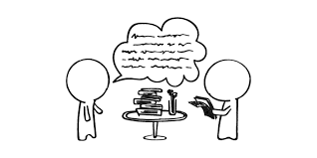
QUALITATIVE RESEARCH
Qualitative research is an inquiry approach in which the inquirer:
explores a central phenomenon (one key concept)
asks participants broad, general questions
collects detailed views of participants in the form of words or images
Not measurements, but WORDS!
  Instead of asking how many times someone purchased an item, you ask "WHY...?"
  Typically the samples are small, and not "random"
Notes:
Before we get started, I’d like to briefly go over your handout. After the title page with the funny little man who has lost all hairs but one to a detestable research project, is a short activity which we’ll dive into in a moment. Following that is an annotated bibliography of many research studies. We’ve noted the gist of each study, type of instrument used, groups studied, setting, etc. to help you along. We will refer to many of these studies throughout the course of this presentation. At the end of the handout is an index of specific research methodologies, such as pre and post test, usability studies, etc. Keep in mind that this bibliogrpahy is not exhaustive by any means. It’s biased towards library instruction and more toward qualitative than quantitative studies—although both are included.
As a way of setting the tone for today’s session, please turn to the inside cover of your handout and look at the 7 descriptions of research methodologies in these studies. I’ll quickly show each of these on the screen, reading them aloud. Then what I would like you to do for the next several minutes is note any questions you have about these methologies, any problems or flaws that you note. Feel free to talk amongst yourselves. Compare notes.
READ SLIDE
(Note to self: self-selection, generalizability, sampling)

Slide 5
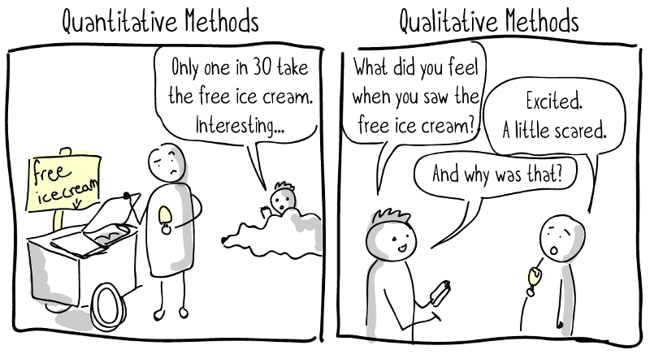
https://uxdesign.cc/a-crash-course-in-ux-design-research-ea00c3307c82#.dzmnof74r

Slide 6
QUALITATIVE APPROACH
Unstructured, open, flexible
Based on “empiricism” which is human learn from sensory experiences (observe, feel, perceive)
Aims to explore diversity rather than quantify
Narration and description rather than measurement
No/Less emphasis on generalization

Slide 7
QUALITATIVE APPROACH
STRENGTHS
WEAKNESS
  Good for examining feelings and motivations
  Allows for complexity and depth of issues
  Provides insights
  No generalization for the whole population
  Volume of data
  Complexity of analysis
  Time-consuming nature of the clerical efforts require

Slide 8
EXAMPLE OF QUALITATIVE RQ
How do parents fell about the use of English as the medium of instruction in mathematics and science?
How does the degree of diversity in a university affect students’ openness to people who are not like them in terms of race, ethnicity, gender and home culture?

Slide 9

QUALITATIVE STUDY DESIGN
CASE STUDIES
OBSERVATION
FOCUS GROUP
ACTION RESEARCH
GROUNDED THEORY

Slide 10
Case Study
Predominantly a qualitative study design, but is also often used in quantitative study
A case can be an individual, a group, a community, an event
An in depth, holistic exploration of the aspects of study
Although assumed as typical case, hence can provide insight into similar cases
Example:
  http://lib.dr.iastate.edu/cgi/viewcontent.cgi?article=3016&context=etd – managing school behaviour
  http://digitalcommons.usu.edu/cgi/viewcontent.cgi?article=1180&context=etd – professional teacher development

Slide 11
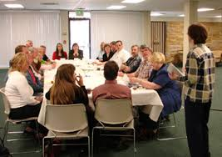
Focus Group
An open discussion about an issue, product, service between members of the group and the researcher
Economical and save time
Optimal size: 8 – 10 members in a group
Examples of a group:
- a group of educational experts
- a group of adolescents ranged 9-11 years old

Slide 12

Observation
Close interaction with members of the group to be studied
Use senses to observe the result
Also can be used in quantitative study
  Use instruments (rulers, cylinder, thermometer etc) to get the result and the result is a measurements
In qualitative study, observation are recorded in a descriptive format
  Quality descriptive
  Example:
    The flowers have soft petals
    Mr. Ezad is very charming proposing Miss Warda
In quantitative study, observations are recorded in categories or scale
  Example:
    5 liters of liquid has leaked from a 2 kiloliter barrel

Slide 13
Action research
Two components: action and research
Aim to improve service quality
Identify areas of concern, develop and test alternatives and approaches

Slide 14






DATA COLLECTION PROCEDURE & METHOD

Slide 15
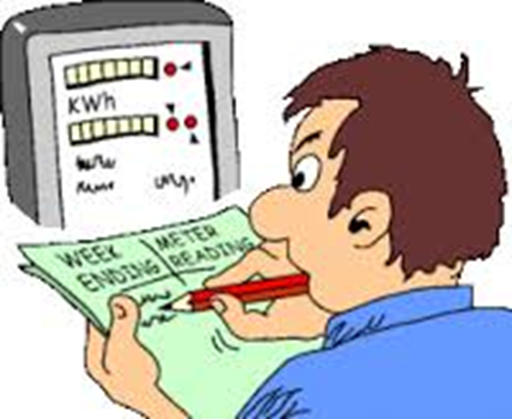
DATA COLLECTION - QUALITATIVE
Qualitative nature:
  Emphasis on seeing the world from the eyes of the participants
  studying the person, group, culture in the natural setting
  Data is collected in the “field” – the natural world where people live and experience life
  Investigator should:
    be nonintrusive
    spend a prolonged time in the field

Slide 16
DATA COLLECTION - QUALITATIVE
Meaning: how people see the world
Context: the world in which people act
Process: what actions and activities people do
Reasoning: why people act and behave the way they do
Notes:
The goals of qualitative research are to understand:
Meaning
Context
Process
Reasoning

Slide 17

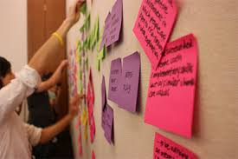
TYPE OF DATA
Structured Text – writing, survey comments, essay, and etc.
Unstructured Text – transcription, focus group, interview, conversation
Audio – music, audio recording
Video - recording
Images – picture, art, and etc.

Slide 18


EXAMPLE: INTERVIEWS
A conversation on a given topic between a respondent and an interviewer
Used to obtain detailed insights and personal thoughts
Flexible and unstructured, but usually with an interview guide
Purpose: to probe informants’ motivations, feelings, beliefs
Lasts about an hour
Interviewer creates relaxed, open environment
Wording of questions and order are determined by flow of conversation
Interview transcripts are analyzed for themes and connections between themes

Slide 19
TYPES OF INTERVIEWS
Informal, conversational interview
  no predetermined questions are asked, in order to remain as open and adaptable as possible to the interviewee’s nature and priorities; during the interview the interviewer “goes with the flow”.
General interview guide approach
  to ensure that the same general areas of information are collected from each interviewee; this provides more focus than the conversational approach, but still allows a degree of freedom and adaptability in getting the information from the interviewee.
Standardized, open-ended interview
  the same open-ended questions are asked to all interviewees; this approach facilitates faster interviews that can be more easily analysed and compared.
Closed, fixed-response interview
  where all interviewees are asked the same questions and asked to choose answers from among the same set of alternatives. This format is useful for those not practiced in interviewing.

Slide 20
EXAMPLE: FOCUS GROUP Process
 | Phase | Action
1. | Opening | Ice-breaker, explain purpose, ground rules; Introduction
2. | Warm up | Relate experience, stimulate group interaction; start with least threatening and simplest questions
3. | Main body | Move to more threatening or sensitive and complex questions; broad participation connect emergent data to complex
4. | Closure | End with closure-type questions, summarize and refine; invite final comments or insights, thank participants

Slide 21
DELPHI METHOD
Delphi is an expert survey in two or more "rounds".
  widely used and accepted method for gathering data from respondents within their domain of expertise
Delphi process: Round 1 -> Round 2 -> Round 3 -> Round 4
Round 1: the Delphi process traditionally begins with an open-ended questionnaire. The open-ended questionnaire serves as the cornerstone of soliciting specific information about a content area from the Delphi subjects
Round 2: each Delphi participant receives a second questionnaire and is asked to review the items summarized by the investigators based on the information provided in the first round.

Slide 22
DELPHI METHOD
Round 3: each Delphi panellist receives a questionnaire that includes the items and ratings summarized by the investigators in the previous round and are asked to revise his/her judgments or “to specify the reasons for remaining outside the consensus”
Round 4: is often as the final round, the list of remaining items, their ratings, minority opinions, and items achieving consensus are distributed to the panellists. This round provides a final opportunity for participants to revise their judgments.

Slide 23
ORGANISATION OF DELPHI PROCESS
Steering Committee
A
B
C
D
E
F
12 Questionnaires/
7000 Adressees
1. Round
2400 Persons
2. Round
1900 Persons
Results, Analysis, Discussion...

Slide 24

Who is an expert?
Broad definition versus high expertise
  Define how broad your expert definition is
    ask them in the questionnaire about their expertise
    laymen for crosschecking?
  Define where your experts are from
    which sectors
    branches
    thematic fields or disciplines...
  Define how many experts you need
    sample must be large enough for the analyses planned
    the more you need, the more expensive it will be
Think about your experts!

Slide 25
PROJECTIVE METHOD
Projective techniques are unstructured and indirect forms of questioning which encourage the respondents to project their underlying motivations, beliefs, attitudes or feelings regarding the issues of concern.
Techniques in projective method:
  Word Association: asks the respondents to give the first word or phase that comes to mind after the researcher presents a word or phrase
  Completion Test: asks the respondents to complete sentences, dialogs, or stories, etc.
  Picture Drawing and Interpretation
  Third Person Techniques
  Role Playing

Slide 26
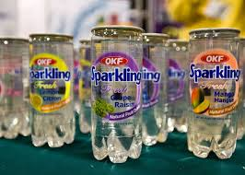
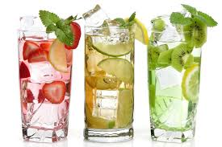
Example: Word Association
Results of a Word Association Test with Alternative
Brand Names for a New Fruit-Flavored Sparkling
Water Drink
Possible Brand Name Associated Words
Ormango Green, tart, jungle
Tropical Fruit Juice, sweet, island
Orange Sparkle Light, bubbly, cool
Paradise Passion Fruity, thick, heavy

Slide 27
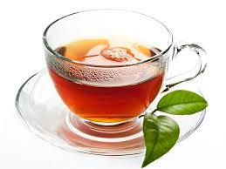
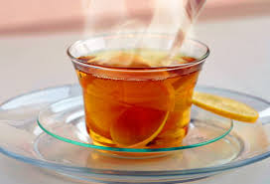
Example: Completion Test
Investigate teenagers’ attitudes to tea
Someone who drinks hot tea is ______________
Tea is good to drink when __________________
Making hot tea is _________________________
My friend thinks tea is _____________________

Slide 28
PROJECTIVE METHOD
ADVANTAGES
DISADVANTAGES
May elicit responses that subjects would be unwilling or unable to give if they knew the purpose of the study. non-threatening
Helpful when underlying motivations, beliefs and attitudes are operating at a subconscious level.
Require highly trained interviewers and interpreters of results
Serious risk of misinterpreting.
Subjectivity
Is the psychological material uncovered related to the topic or to the person?

Slide 29
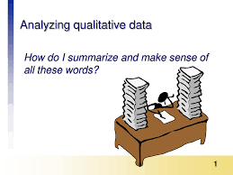
QUALITATIVE DATA ANALYSIS
Not limited to:
                Open Coding
                Affinity Diagramming
                Grounded Theory
                Narrative Analysis

Slide 30
DATA ANALYSIS – OPEN CODING
Treat data as answers to open-ended questions
  ask data specific questions
  assign codes for answers
  record theoretical notes

Slide 31
OPEN CODING – AN EXAMPLE: Calendar Routines
(Neustaedter, 2007)
Families were interviewed about their calendar routines
  What calendars they had
  Where they kept their calendars
  What types of events they recorded
  …

Slide 32
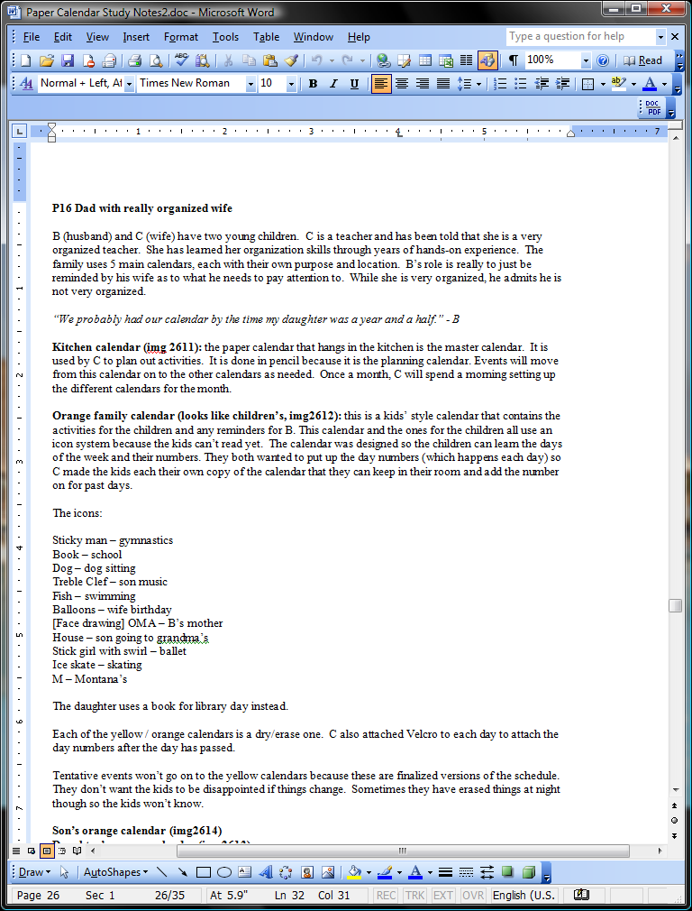
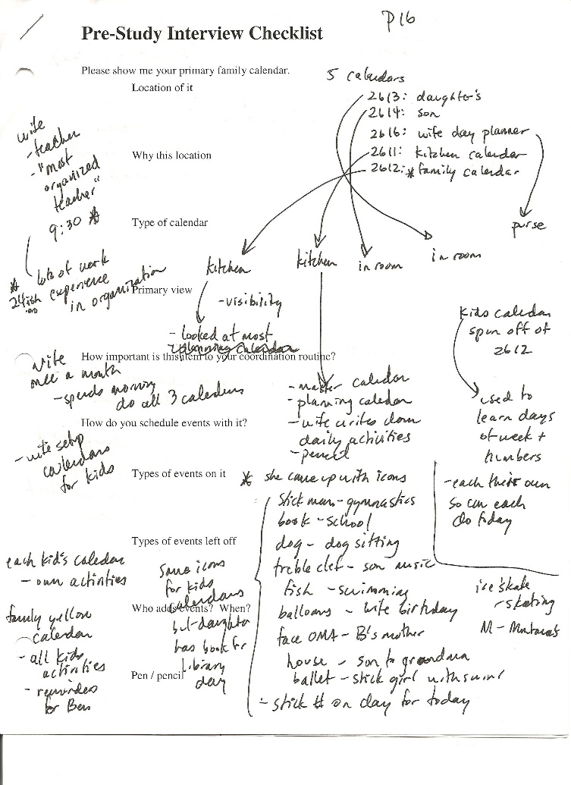
Example: Calendar Routines
Step 1: translate field notes (optional)
paper
digital

Slide 33
Example: Calendar Routines
Step 2: list questions / focal points
Where do families keep their calendars?
What uses do they have for their calendars?
Who adds to the calendars?
When do people check the calendars?
…
(you may end up adding to this list as you go through your data)

Slide 34
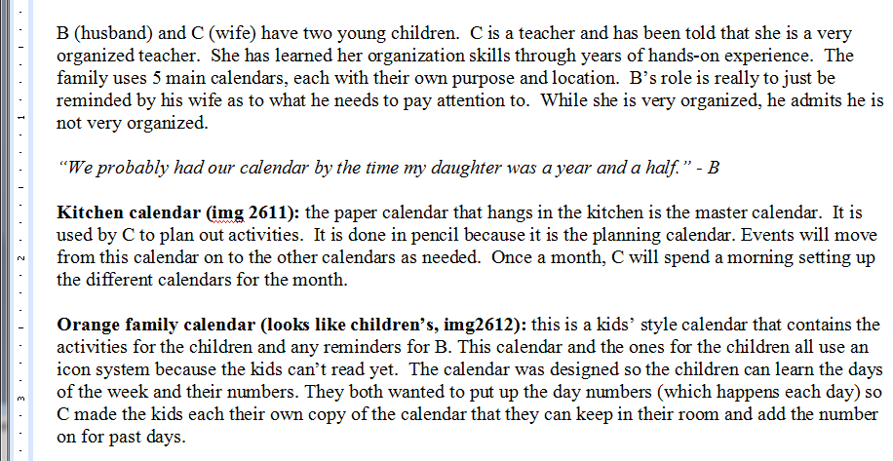
Example: Calendar Routines
Step 3: go through data and ask questions
Where do families keep their calendars?

Slide 35
Example: Calendar Routines
Step 3: go through data and ask questions
Calendar Locations:
[KI] – the kitchen
[KI]
[KI]
[KI]
Where do families keep their calendars?

Slide 36
Example: Calendar Routines
Step 3: go through data and ask questions
Calendar Locations:
[KI] – the kitchen
[CR] – child’s room
[KI]
[CR]
Where do families keep their calendars?

Slide 37
Example: Calendar Routines
Step 3: go through data and ask questions
Calendar Locations:
[KI] – the kitchen
[CR] – child’s room
[KI]
[CR]
Continue for the remaining questions….

Slide 38
Example: Calendar Routines
The result:
  list of codes
  frequency of each code
  a sense of the importance of each code
  frequency != importance

Slide 39
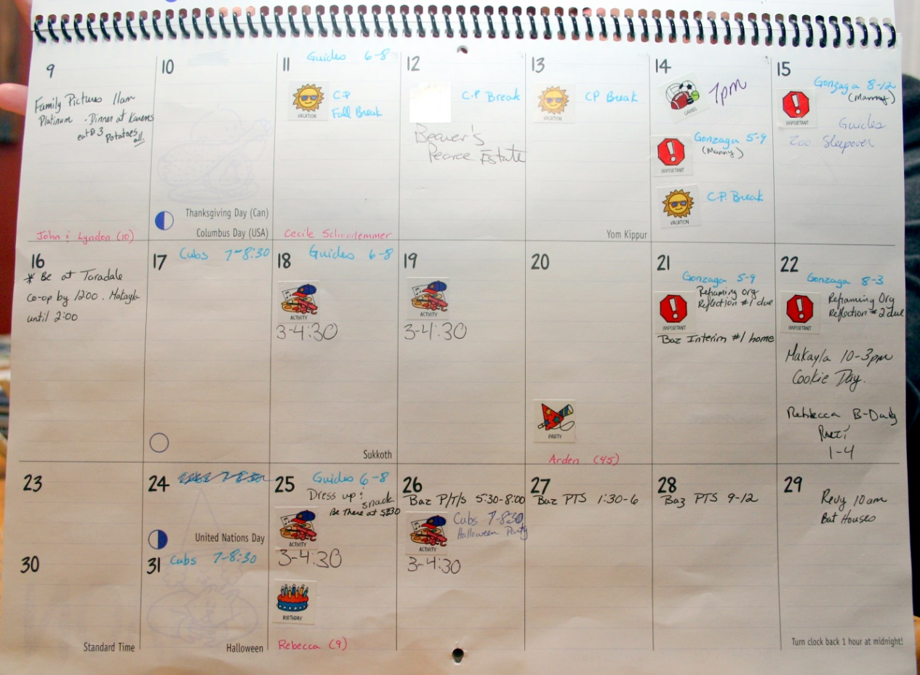
OPEN CODING - EXAMPLE 2: CALENDAR CONTENTS
(Neustaedter, 2007)
Pictures were taken of family calendars

Slide 40
Example: Calendar Contents
Step 1: list questions / focal points
What type of events are on the calendar?
Who are the events for?
What other markings are made on the calendar?
…
(you may end up adding to this list as you go through your data)

Slide 41
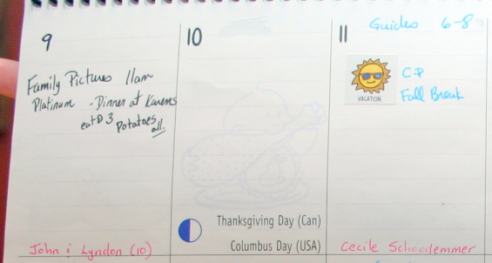
Example: Calendar Contents
Step 2: go through data and ask questions
What types of events are on the calendar?

Slide 42
Example: Calendar Contents
Step 2: go through data and ask questions
[FO]
Types of Events:
[FO] – family outing
What types of events are on the calendar?

Slide 43
Example: Calendar Contents
Step 2: go through data and ask questions
[FO]
Types of Events:
[FO] – family outing
[AN] - anniversary
[AN]
What types of events are on the calendar?

Slide 44
Example: Calendar Contents
Step 2: go through data and ask questions
[FO]
Types of Events:
[FO] – family outing
[AN] - anniversary
[AN]
Continue for the remaining questions….

Slide 45
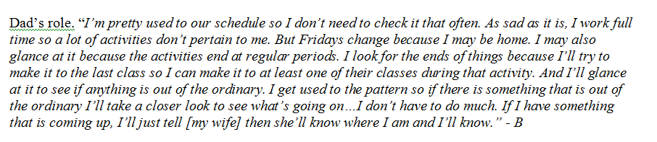
Reporting Results
Find the main themes
Use quotes / scenarios to represent them
Include counts for codes (optional)

Slide 46
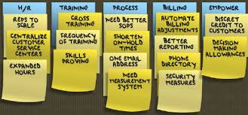
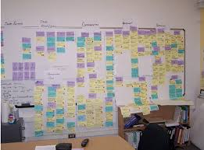
AFFINITY DIAGRAM
Goal: what are the main themes?
  Write ideas on sticky notes
  Place notes on a large wall / surface
  Group notes hierarchically to see main themes

Slide 47

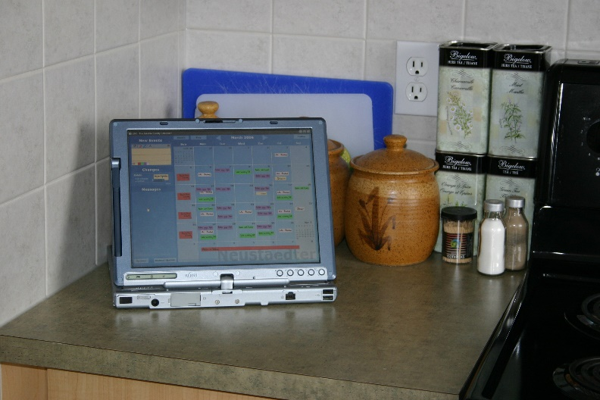

AFFINITY DIAGRAM - Example: Calendar Field Study
(Neustaedter, 2007)
Families were given a digital calendar to use in their homes
Thoughts / reactions recorded:
  Weekly interview notes
  Audio recordings from interviews

Slide 48
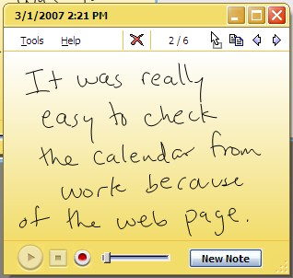
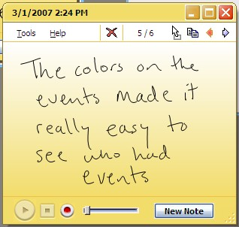
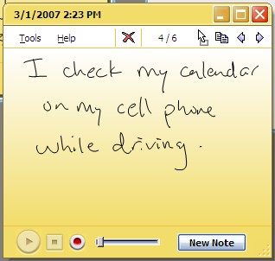
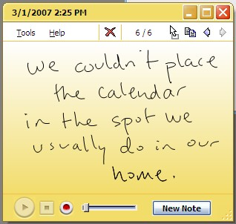
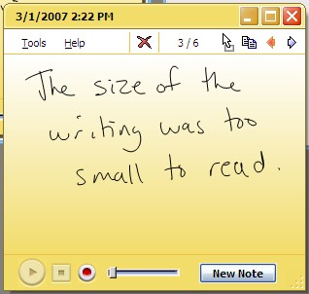
Example: Calendar Field Study
Step 1: Affinity Notes
  go through data and write observations down on post-it notes
  each note contains one idea

Slide 49
Example: Calendar Field Study
Step 2: Diagram Building
  place all notes on a wall / surface

Slide 50
Example: Calendar Field Study
Step 3: Diagram Building
  move notes into related columns / piles

Slide 51
Example: Calendar Field Study
Step 3: Diagram Building
  move notes into related columns / piles

Slide 52
Example: Calendar Field Study
Step 3: Diagram Building
  move notes into related columns / piles

Slide 53
Example: Calendar Field Study
Step 3: Diagram Building
  move notes into related columns / piles

Slide 54
Example: Calendar Field Study
Step 3: Diagram Building
  move notes into related columns / piles

Slide 55
Example: Calendar Field Study
Step 3: Diagram Building
  move notes into related columns / piles

Slide 56
Example: Calendar Field Study
Step 3: Diagram Building
  move notes into related columns / piles

Slide 57
Example: Calendar Field Study
Step 4: Affinity Labels
  write labels describing each group

Slide 58
Example: Calendar Field Study
Step 4: Affinity Labels
  write labels describing each group
Calendar placement is a challenge

Slide 59
Example: Calendar Field Study
Step 4: Affinity Labels
  write labels describing each group
Calendar placement is a challenge
Interface visuals affect usage

Slide 60
Example: Calendar Field Study
Step 4: Affinity Labels
  write labels describing each group
People check the calendar when not at home
Calendar placement is a challenge
Interface visuals affect usage

Slide 61
EXAMPLE of CASE STUDY
Phase 4: The case studies (April 07-June 08)
Activities | Objectives | Methods/Tools | Deliverables
Data Collection | To conduct case studies To gather data | Interviews Observations Document analysis | Interview transcripts Document and observation memo
Analysis | To analyse collected data to understand the overall studies context and to identify appropriation criteria | Nvivo 8 | Analysis result
Findings | To update the existing identified criteria from the pilot case study and preliminary survey |  | Updates of appropriation criteria

Slide 62



QUALITATIVE ANALYSIS RESEARCH SOFTWARE/TOOLS
ATLAS.TI
  http://atlasti.com/
NVIVO
  http://www.qsrinternational.com/what-is-nvivo
QDA MINER
  https://provalisresearch.com/products/qualitative-data-analysis-software/
CONTENT ANALYSIS – LightSide: Machine Learning for TEXT
  http://www.cs.cmu.edu/~cprose/LightSIDE.html

Slide 63
THANK YOU
END OF TOPIC 5

